Slide 1

UNIX - Fundamentals
7
Simple Filters
9
SED
5
The shell
cmp comm diff head and tail …
Inserting
Updating
Deleting
RegEx….
1
UNIX Intro
3
Unix File System
Pattern matching
Escaping Redirecting…
The UNIX OS
The Linux OS
Features of Unix
The file
pwd and cd
mkdir
ls and cp ..
Shell Programming
8
GREP
10
6
The Processes
The character class
The *
The Dot…
condition eval
loops
read
exit status
4
Vi/Vim editors
ps nohup at and batch
2
Unix Commands
Input mode
Saving text
Aborting…
command basics
man
echo
printf …
Biz Nigatu
Software Engineer and Instructor
reckonedforce.com
@bizNigatu

Slide 2
Section 6 – UNIX Fundamentals
The Shells
Setting Your Shell
Environment Variables
export: Creating Environment Variables
The Common Environment Variables
Aliases
Command History
Accessing Previous Commands
Substitution in Previous Commands
Using Arguments to Previous Command ($_)
The History Variables
In-line Command Editing
Tilde Substitution
Using set Options
The Initialization Scripts
Directory Stack Manipulation

Slide 3
Chapter 8 - *** Shell Customization

Slide 4
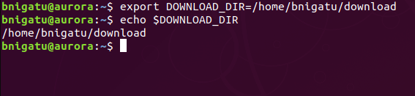
Environment Variables
Shell variables are of two types-local and environment. PATH, HOME, and SHELL are environment variables. They are so called because they are available in the user’s total environment.
export: Creating Environment Variables
The env command displays only environment variables.
Example: create DOWNLOAD_DIR variable and make it visible in all child processes, by exporting it ‘DOWNLOAD_DIR=/home/bnigatu/download’

Slide 5
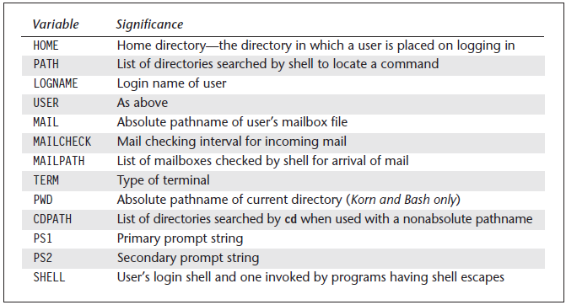
Common Environment Variables
Environment variables control the behavior of the system. Many of these common environment variables are exported and made available to the shell by its ancestors.

Slide 6
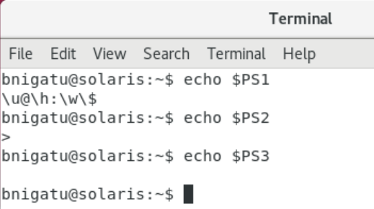
The Prompt Strings
echo $PS1; echo $PS2; echo $PS3
Notice, for $PS1, there are control characters: \u = user name and \w = print working directory
$PS2 is used for line continuations, e.g. if you require, for example, a ‘;’ at the end but don’t have it, you will continue to the next line. $PS2 will prompt ‘>‘ to make it clearer what needed to be done.
$PS3 is blank.

Slide 7
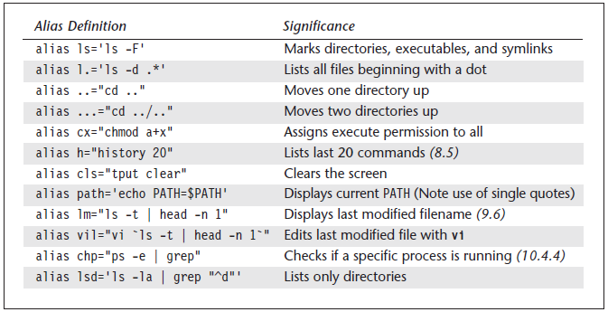
Useful Aliases
The shell supports aliases as a mechanism of assigning shorthand names for commands or for redefining commands to run with specific options. Aliasing is done with the alias statement, a built-in feature of the shell.

Slide 8
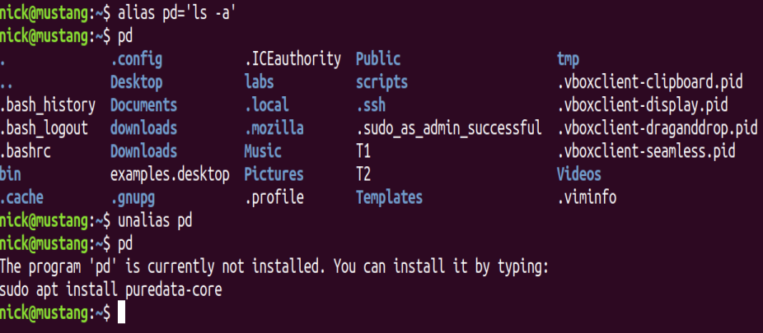
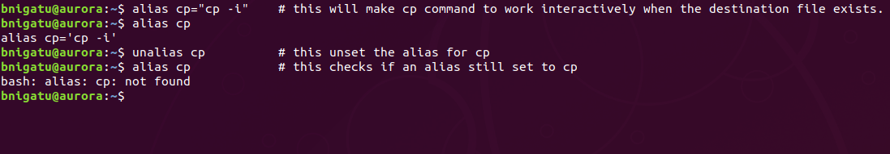
Unalias
First, created a an alias to ‘cp’ is assigned the command ‘cp -i’
Displayed the output of ‘cp’
‘unalias cp’ to get rid of it
Run ‘cp’ again to display an error

Slide 9
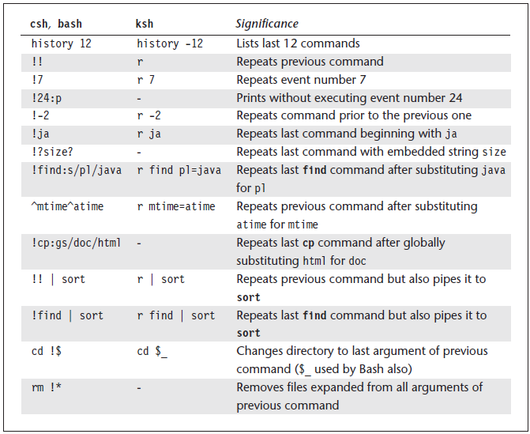
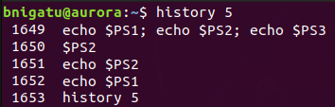
History Commands
The history feature lets you recall previous commands (even those executed in previous sessions), edit them if required, and re-execute them. The shell assigns each command an event number.
Example:
Using a numeric argument, we can display the last five commands

Slide 10
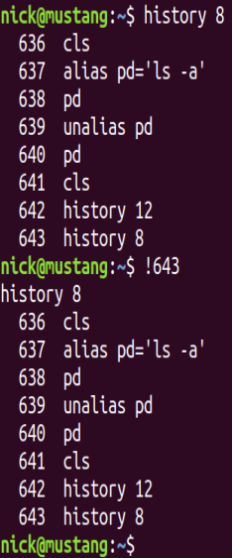
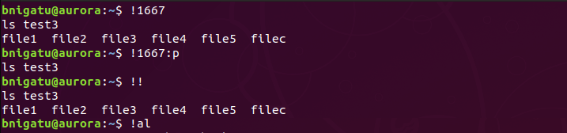
History (Accessing Previous Commands)
Example
Re-executes event number 1667
Displays only
Repeats last command
Repeats last command beginning with al

Slide 11
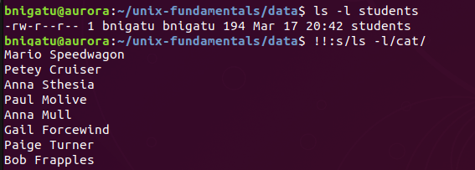
History with Substitution
Often you may need to execute a previous command but only after replacing a string in the command line with another. One can use a sed like substitution ‘:s’ modifier and the ‘/’ to delimit the old and new patterns.
Example:
We first checked the file info using ls –l
Then we used :s to replace the last command with new (cat) command

Slide 12
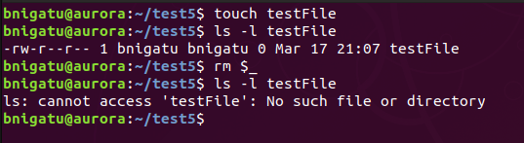
Arguments to Previous Commands
You can use the previous command as an argument to a new command by ‘$_’

Slide 13
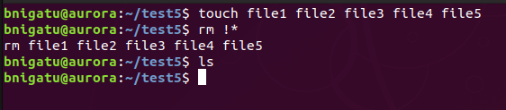
Arguments to Previous Commands
How about using arguments to previous commands as arguments to current commands?
Create three files using ‘touch’
Then use ‘rm !*’ to remove them – does it work?
Why?
What is removed?

Slide 14
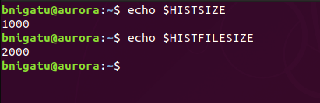
History Variables
Bash stores all previous commands in ‘$HOME/.bash_history’
You can use ‘HISTFILE’ to assign a different name
There are two variables that determine the size of the list both in memory and on disk:
‘HISTSIZE=1000’ - memory
‘HISTFILESIZE=2000’ – on disk
In memory
On disk

Slide 15
In-line Command Editing. Using set Options
Bash provides vi-like capabilities of editing the command line, both the current command and its predecessors in the history list
Make the following setting: ‘set –o vi’ (you can do this in your .bashrc file or at the command line
Now, type ‘<ESC>’
Type ‘k’ a few times then type ‘j’
Trying to move the cursor up or down will actually recall the previous or next commands in history

Slide 16
Pattern Searching In-line
Want to search the history for a command?
‘ESC’ followed by the pattern you’re searching for
Enter the pattern you’re searching for such as ‘/uname’
You will see the $ prompt
Press ‘n’ to go forward and ‘N’ to go backwards
You can use standard ‘vi’ editing commands to edit the line you want

Slide 17
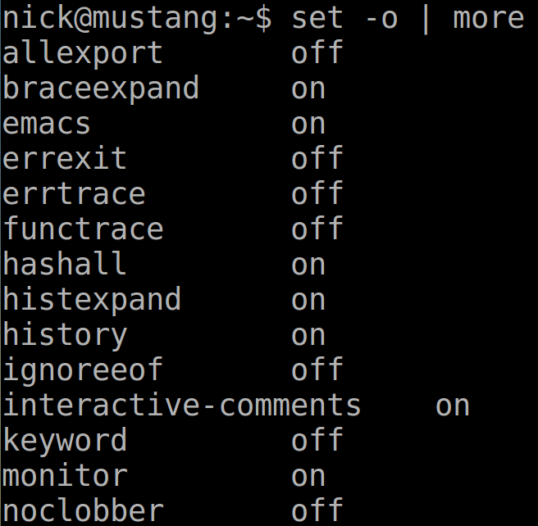
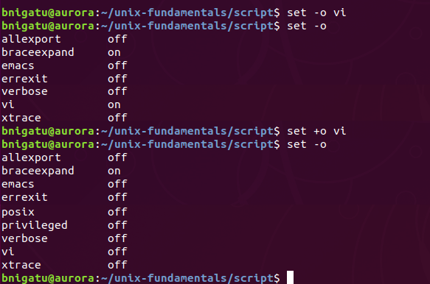
Displaying ‘set’ Status’
-o =turn on
To display the status of the various ‘-o’ commands, use ‘set –o’ without any arguments.
+o =turn off

Slide 18
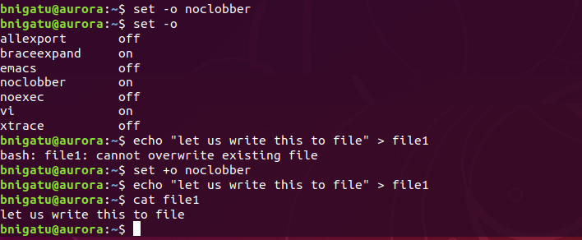
Using ‘set’ Options
The ‘set’ statement by default displays all variables but it can make several environment settings with the –o keyword option
‘set –o noclobber’ prevents accidental file overwriting (clobbering) with the ‘>’ and the ‘>>’ symbols

Slide 19
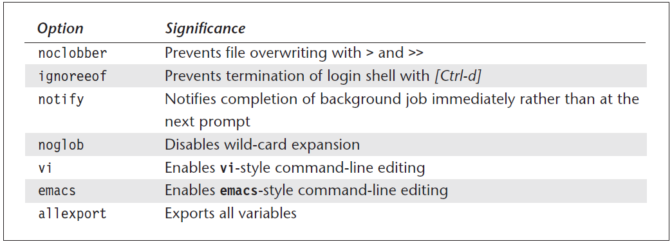
Shell Settings with ‘set –o’
If you want to make sure you ONLY use ‘exit’ to logout, set ‘ignoreeof’
When we start writing actual shell programs, it will be helpful to set the ‘allexport’

Slide 20
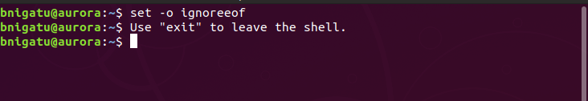
Force ‘exit’ to Logout (Exit Shell)
<CTRL + D> will generate this error
These example all use the current shell; when you log out, they go away. To make them permanent, you will need to include them in your startup scripts, e.g. .bashrc or .bash_profile.
Profile scripts are only executed once – when you log in or use ‘source’ following changes.
Bash uses one or more of three files: ‘.bashrc’, ‘.bash_profile’, ‘.profile’

Slide 21
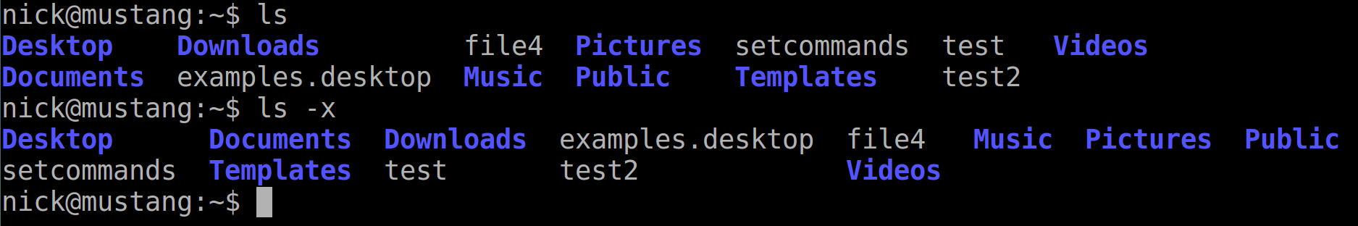
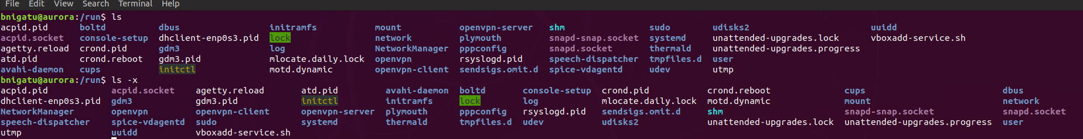
Using ‘ls’ and ‘ls –x’
‘ls’ displays all files in a columnar format; however, notice that the files are listed, sorted, from top-to-bottom.
Where as, ‘ls –x’ – they are sorted by row.

Slide 22
Initialization Scripts ***
Fedora uses both ‘.bashrc’ and ‘.bash_profile’
Ubuntu uses ‘.bashrc’ and ‘.profile’
‘.profile’
PATH=$PATH:$HOME/bin:.:
PS1=‘\u@aurora \w $ ‘
PS2=‘continue: ’
TERM=vt100
‘echo “Today’s date is `date`”

Slide 23
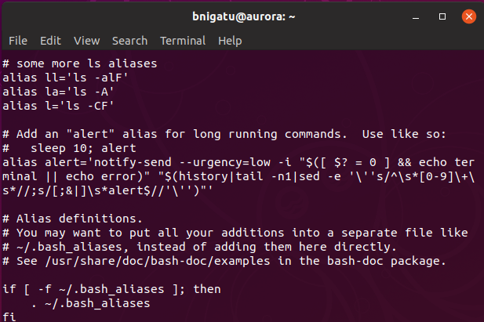
‘.bashrc’ Contents
‘.bashrc’
Aliases
Export BASH_ENV=$HOME/.bashrc
HISTSIZE
HISTFILE
‘set –o vi’
‘set o noclobber’
‘set o ignoreeof’
‘set o allexport’

Slide 24
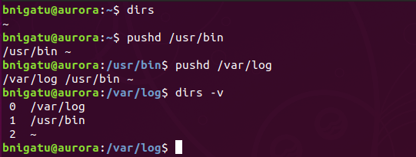
Directory Stack Manipulation
Bash provides a directory stack that you can fill in with the directories that you visit frequently.
This is especially useful when you use three or more directories. For just two directories you my use ‘cd –’ to navigate to the previous directory
Consider this a shortcut to switch to any of these directories
Use ‘dirs’, ‘pushd’ and ‘popd’ commands to list the stack and push directories into and remove directories from the stack

Slide 25
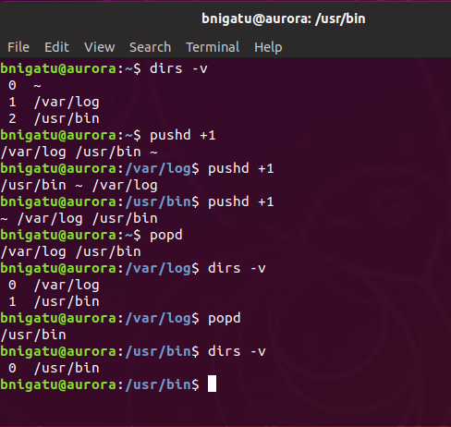
‘dirs’ ‘pushd’ ‘popd’: Fast Navigation
The ‘dirs –v’ is verbose, it displays all directories and associated number in the stack
We do a ‘pushd +1’ which moves the stack to the old position then
Lastly, ‘popd’ removes (pops out) a directory from the stack
1
2
3

